Slide 1

M3K4 TEAM
M3K4RM PROJECT

Slide 2
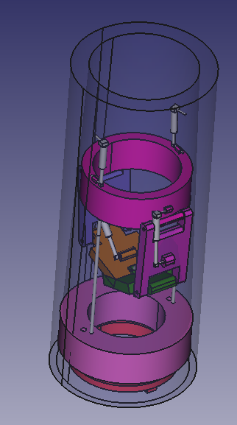
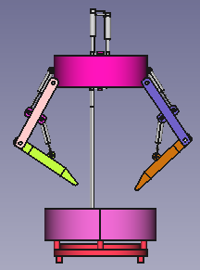
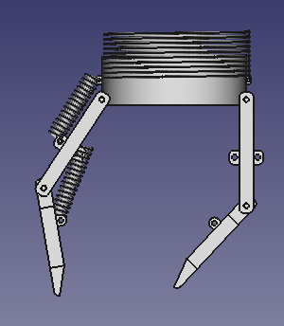
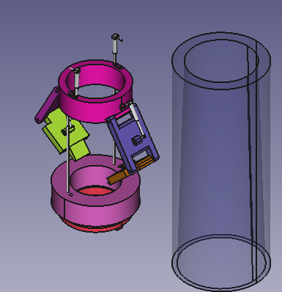
Initially, our system is contained in a 12 cm long and 2 cm wide tube.
Here is the view outside the tube.
The Dampers in the images represent the spring structures as in the image on the right.

Slide 3
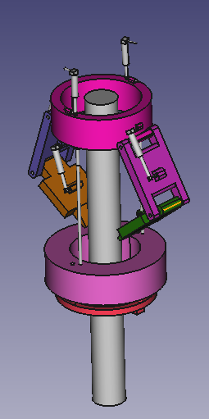
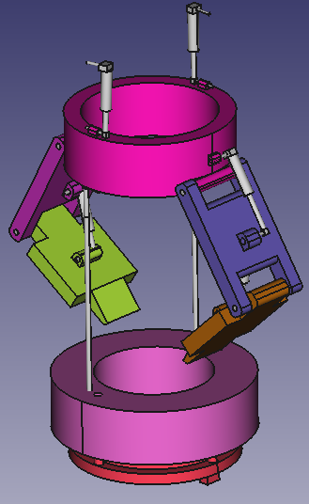
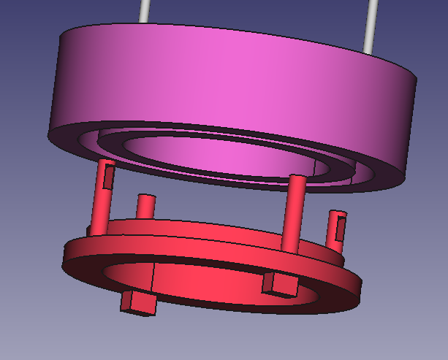
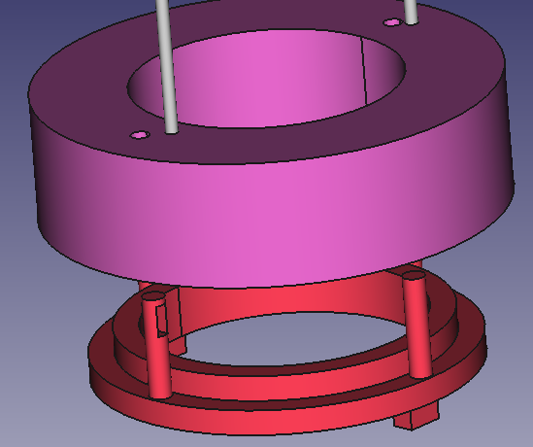
There is a gap in the middle, so that the cable to be cut is passed from top to bottom. The other ropes on the side are steel cables, they are attached to the pulley below.
The reel is rotated from below and the winding process takes place, so that the upper ring is stretched downwards, and the static force is stored as the springs above it will be stretched in this way.

Slide 4
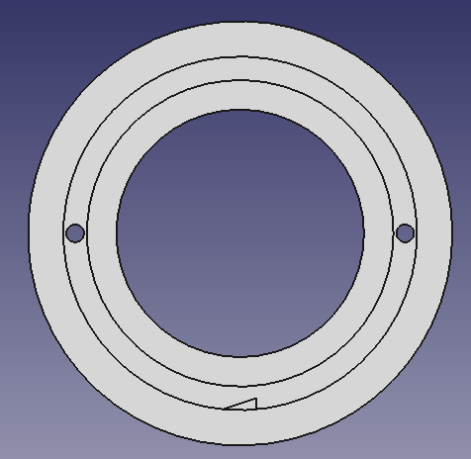
The steel cable, which is wound on the reel below, is held by a protrusion connected to the relay. The relay releases the protrusion with a momentary trigger of electrical energy, so that the steel cable comes out of the coil.

Slide 5
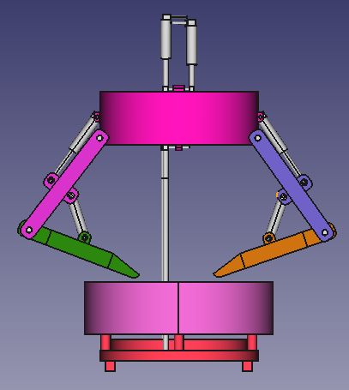
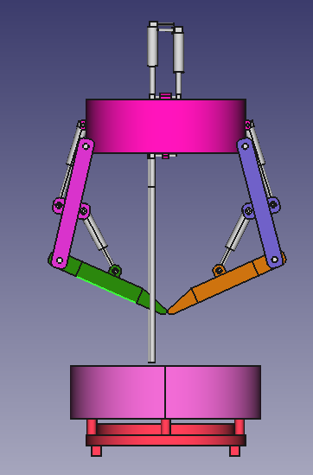
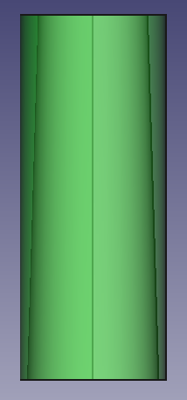
The upper ring, which is released with the help of the statically loaded spring at the top, quickly goes up. The scissors system, which is connected to the bracelet with 2 diamond tips, closes while passing up in the conical shell in which it is located, and thus the cable between is cut.

Slide 6
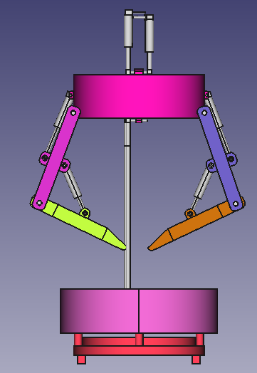
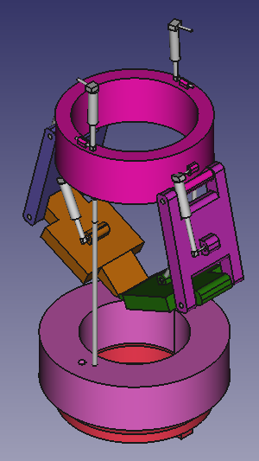
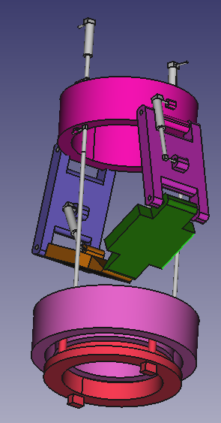

Slide 7
Crew
Mahmut Sami Gömeçoğlu
Mechatronics Engineer
Furkan Önder
Mechatronics Engineering Student

